Slide 1




PRICE INSTITUTIONAL REPOSITORY
DSpace 9.2
A guided walkthrough of the new front-end, and how every faculty can self-archive their research.
Open Repository
Front-End Tour
Self-Archiving
PRICE Research Institute • Living Seed, Gboko

Slide 2

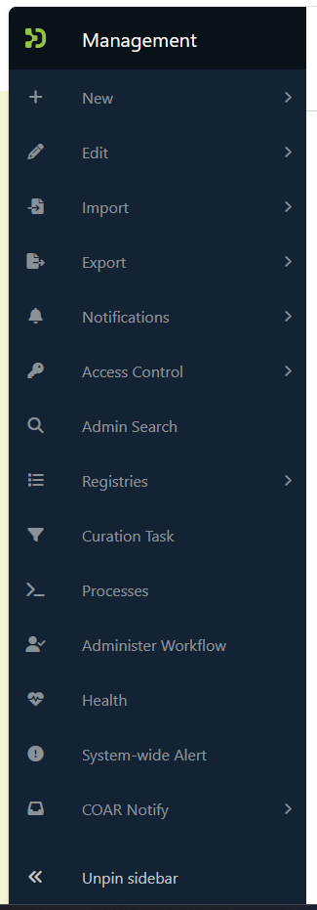
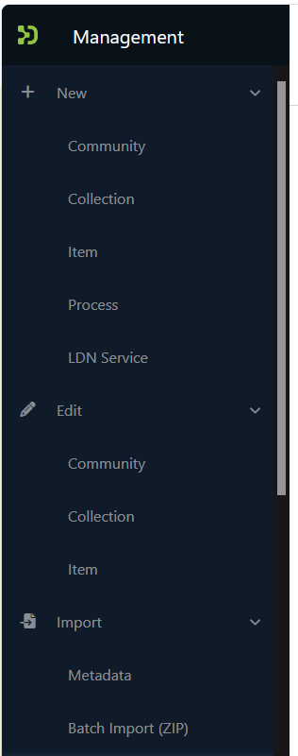


PRICE INSTITUTIONAL REPOSITORY
Walking Through the Front-End
The Management console — the real DSpace 9.2 admin sidebar editors and reviewers work from every day.
New & Edit
Create or update Communities, Collections, Items, Processes, and LDN Services.
Import & Export
Bulk metadata and ZIP import/export, right from the Management menu.
Access Control & Notifications
Manage People, Groups, Bulk Access, and Publication Claims.
Registries & COAR Notify
Metadata/format registries, curation tasks, and LDN services in one place.
Collapsed menu
“New” expanded

Slide 3



PRICE INSTITUTIONAL REPOSITORY
How Each Faculty Can Self-Archive
A five-step submission workflow — no technical or library support required.
1
2
3
4
5
Log In
→
Start Submission
→
Describe the Work
→
Upload Files
→
Submit for Review
Sign in with institutional credentials.
Choose your faculty's collection and click “New Item.”
Enter title, author(s), abstract, date, and subject terms.
Attach the PDF or dataset and accept the deposit license.
Item routes to the faculty reviewer, then goes live.
Need help? The LIDC support desk is available to assist any faculty with their first submission.

